Slide 1
REPRESENTATION KNOWLEDGE IN ARTIFICIAL INTELLIGENCE
ĐỀ TÀI: XÂY DỰNG CHƯƠNG TRÌNH CHUYỂN ĐỔI NGÔN NGỮ TỰ NHIÊN TRONG HÌNH HỌC PHẲNG SANG NGÔN NGỮ ĐẶC TẢ NHÓM 13: NGUYỄN ĐỨC HÙNG HÀ NHẬT HUY ĐOÀN TRÍ LINH HUỲNH TRỌNG NHÂN CAO HOÀI NHIÊN

Slide 2
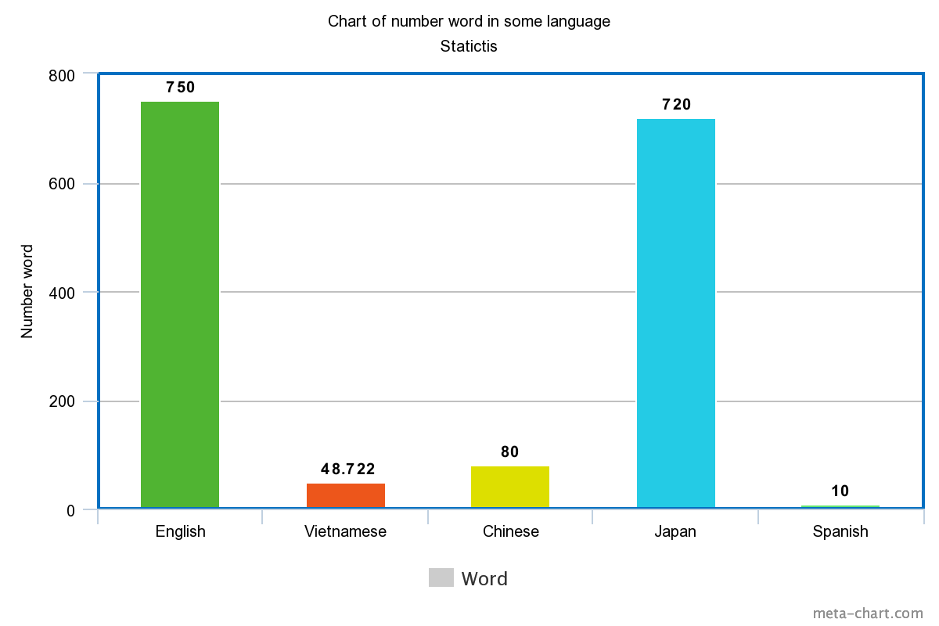

Slide 3

SO, WHAT IS A REPRESENTATION KNOWLEDGE ???
IS A TYPE OF FORM EDUCATION ?
WHICH ‘S ACQUISITION THE KNOWLEDGE,
WAS REPRESENTATION ?
HOW MANY TYPE OF KNOWLEDGE IN THIS MAJOR?
AND FINALLY, HOW IT CAN SHOW THE KNOWLEDGE
WHICH WAS LEARNED ?
Slide 5

Slide 4
TYPE OF KNOWLEDGE
Descreptive
Explicit
Procedural
Implicit
Certain
Uncertain
Next

Slide 5
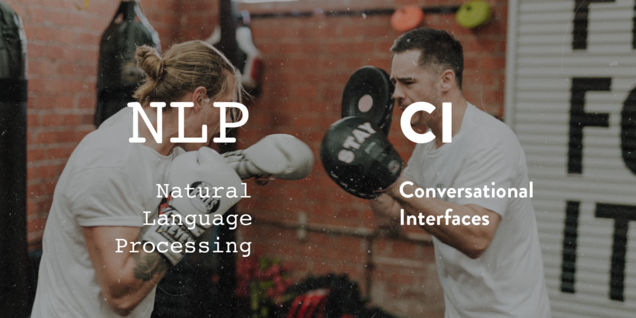
HOW ABOUT MAJOR NATURAL LANGUAGE PROCESSING ?

Slide 6

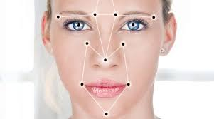

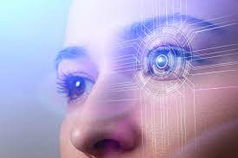

Slide 7


Slide 8
INTRODUCTION MODEL COKB TO REPRESENT KNOWLEDGE IN MATHMATICS
WHAT IS IT ? AND WHAT INSIDE IS IT ?
WHAT DOES IT BE USED IN ?
WHO IS THE ORIGINAL AUTHOR AND ORIGIN OF IT ?
WHY USE THIS MODEL AND NOT OTHER ?

Slide 9
MAPLE, THE WONDERFUL TOOL FOR PROCESS LAST STEP
INTRODUCING, MAPLE AND MAPLE CORE
HOW TO USAGE IT
WHAT IS IT USE FOR?

Slide 10
THE PROBLEMS
NLP IS A MAJOR WHICH STILL TOO STRANGE WITH ALL OF STUDENT
NLP HAS WEIGHT CHARACTERISTICS OF KNOWLEDGE ABOUT LOGIC
SO LEARNING KNOWLEDGE IS A LONG TERM OF LEARNING
TO TRANSFER SOME KNOWLEDGE TO SOMETHING THE BEST WE SHOULD UNDERSTAND IT

Slide 11


